Slide 1
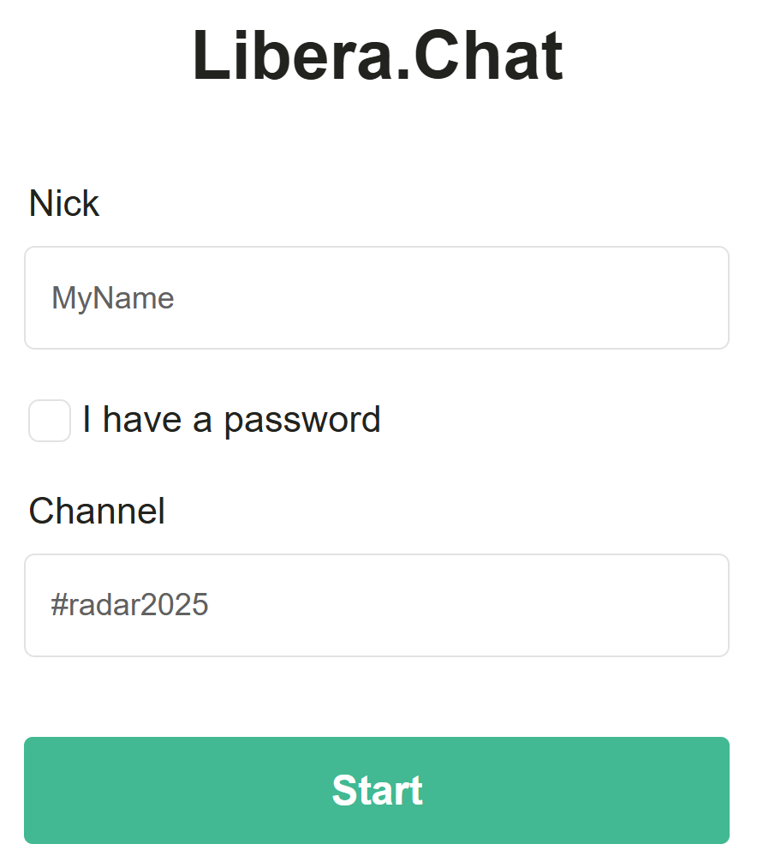
Overall Requirements
Lab code - download zip from https://tinyurl.com/adbfzip
It’s just an alias to download the latest code from our workshop repo-
https://github.com/777arc/RADAR-2025-Beamforming-Labs
Python 3 with numpy and matplotlib installed
Next slides show detailed install steps for 1) Windows and 2) Browser-only option
Marc will be available to help through text-based chat here https://web.libera.chat/
Nick: Your name/alias
(Don’t check the password box)
Channel: #radar2025

Slide 2

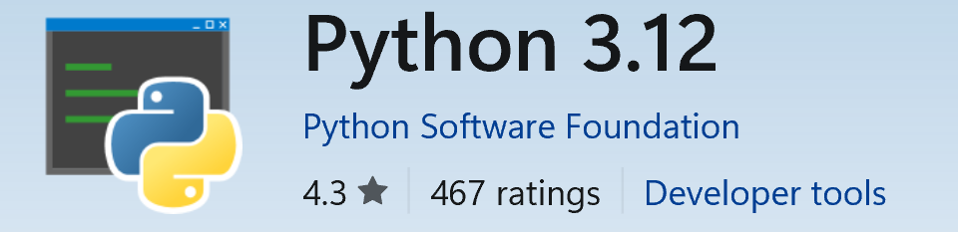
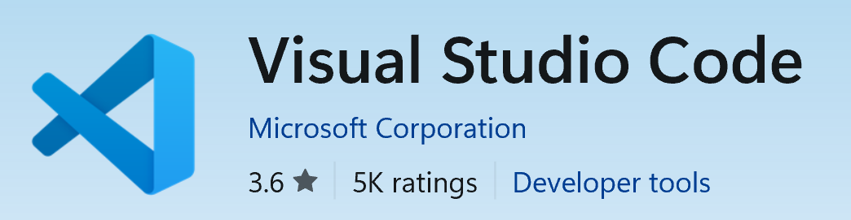
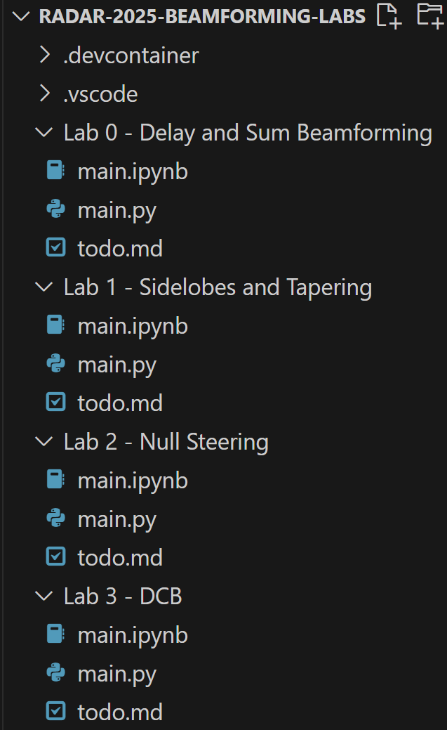
Windows Setup
Open Microsoft Store
Search for and install Python 3.12
Also search and install Visual Studio Code
Open VSCode desktop app
Download zip from https://tinyurl.com/adbfzip then unzip it
Alias for our code on https://github.com/777arc/RADAR-2025-Beamforming-Labs
In VSCode, go to File > Open Folder > choose the unzipped folder
Terminal > New Terminal > run the following command:
pip install numpy scipy matplotlib
We recommend using the .py file for each lab
Play button on the top-right can be used to run each Python script

Slide 3

Browser-only (No-Install) Method
If you don’t want to (or can’t) install anything on your laptop, use this method
Log into your GitHub account, or create one if you don’t already have one, at github.com
In a browser go to https://tinyurl.com/adbf2025
Alias for https://codespaces.new/777arc/RADAR-2025-Beamforming-Labs
Click
It will create a new Codespace in your GitHub account, with all of our code, RF recordings, and it will use a prebuilt linux image we set up just for this lab
After a minute you should see a web-based VSCode interface, and the Labs on the left
Use the .ipynb versions of the lab code (images wont show up with the .py version)
Open Lab 0 -> main.ipynb
In the upper right, Select Kernel and choose Python 3.12
For each lab, there's a Run All button at the top, or control-enter is a hotkey for running an individual code cell
At any time you can stop or delete codespaces at https://github.com/codespaces/

